Slide 1

Unit III- Big Data Processing
1

Slide 2
Introduction to Big Data
What is Big Data?
What makes data, “Big” Data?
2

Slide 3
Big Data Definition
No single standard definition…
“Big Data” is data whose scale, diversity, and complexity require new architecture, techniques, algorithms, and analytics to manage it and extract value and hidden knowledge from it…
3

Slide 4
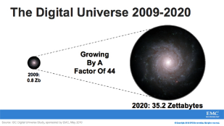
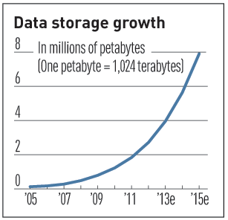

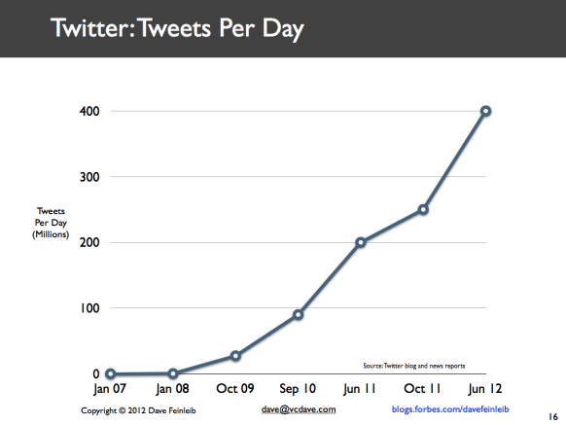
Characteristics of Big Data: 1-Scale (Volume)
Data Volume
44x increase from 2009 2020
From 0.8 zettabytes to 35zb
Data volume is increasing exponentially
Exponential increase in collected/generated data
4

Slide 5
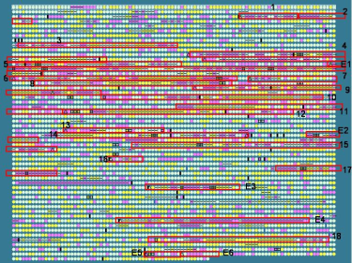

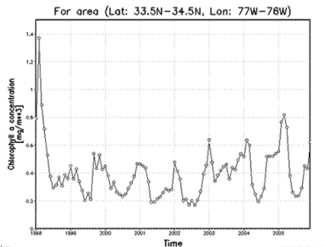
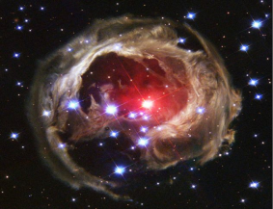
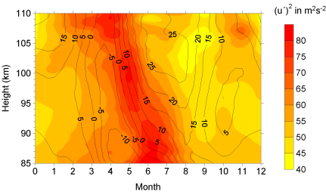

Characteristics of Big Data: 2-Complexity (Varity)
Various formats, types, and structures
Text, numerical, images, audio, video, sequences, time series, social media data, multi-dim arrays, etc…
Static data vs. streaming data
A single application can be generating/collecting many types of data
To extract knowledge➔ all these types of data need to linked together
5

Slide 6

Characteristics of Big Data: 3-Speed (Velocity)
Data is begin generated fast and need to be processed fast
Online Data Analytics
Late decisions ➔ missing opportunities
Examples
E-Promotions: Based on your current location, your purchase history, what you like ➔ send promotions right now for store next to you
Healthcare monitoring: sensors monitoring your activities and body ➔ any abnormal measurements require immediate reaction
6

Slide 7
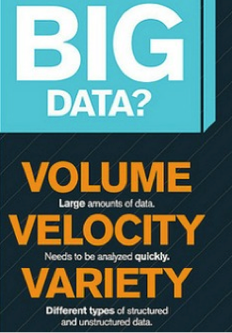

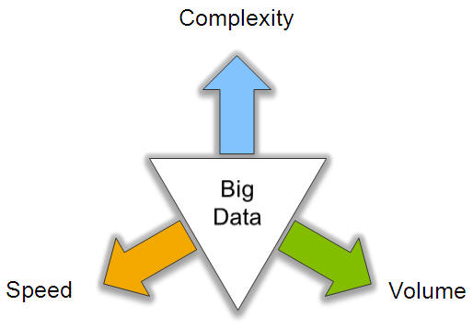
Big Data: 3V’s
7

Slide 8
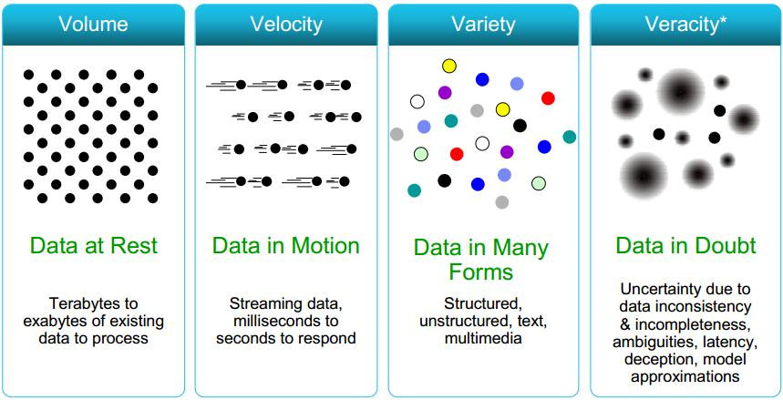
Some Make it 4V’s
8

Slide 9
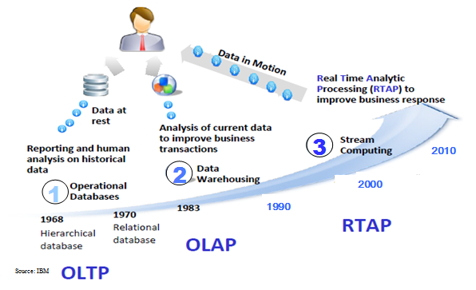
Harnessing Big Data
OLTP: Online Transaction Processing (DBMSs)
OLAP: Online Analytical Processing (Data Warehousing)
RTAP: Real-Time Analytics Processing (Big Data Architecture & technology)
9

Slide 10

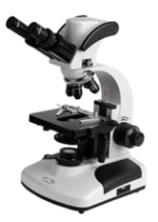




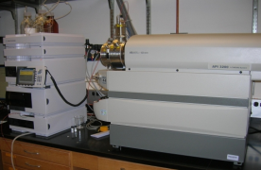
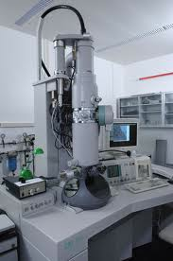
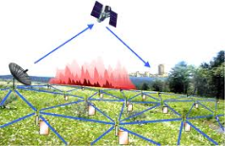

Who’s Generating Big Data
Mobile devices
(tracking all objects all the time)
Social media and networks
(all of us are generating data)
Scientific instruments
(collecting all sorts of data)
Sensor technology and networks
(measuring all kinds of data)
The progress and innovation is no longer hindered by the ability to collect data
But, by the ability to manage, analyze, summarize, visualize, and discover knowledge from the collected data in a timely manner and in a scalable fashion
10

Slide 11




The Model Has Changed…
The Model of Generating/Consuming Data has Changed
Old Model: Few companies are generating data, all others are consuming data
New Model: all of us are generating data, and all of us are consuming data
11

Slide 12
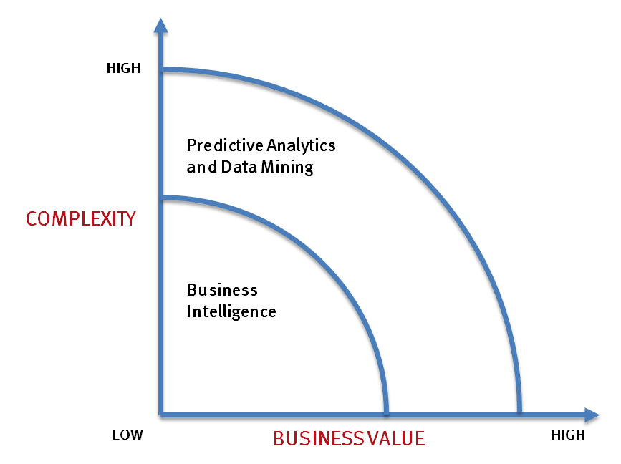
What’s driving Big Data
- Optimizations and predictive analytics
- Complex statistical analysis
- All types of data, and many sources
- Very large datasets
- More of a real-time
- Ad-hoc querying and reporting
- Data mining techniques
- Structured data, typical sources
- Small to mid-size datasets
12

Slide 13
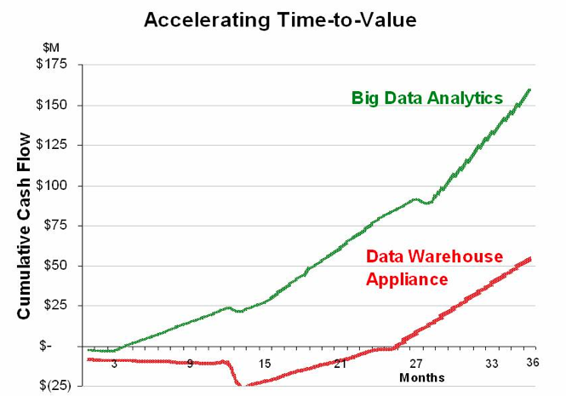
Value of Big Data Analytics
Big data is more real-time in nature than traditional DW applications
Traditional DW architectures (e.g. Exadata, Teradata) are not well-suited for big data apps
Shared nothing, massively parallel processing, scale out architectures are well-suited for big data apps
13

Slide 14
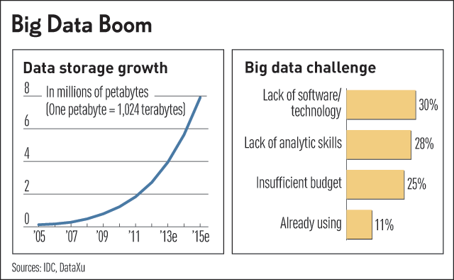
Challenges in Handling Big Data
The Bottleneck is in technology
New architecture, algorithms, techniques are needed
Also in technical skills
Experts in using the new technology and dealing with big data
14

Slide 15
What Technology Do We Have
For Big Data ??
15

Slide 16
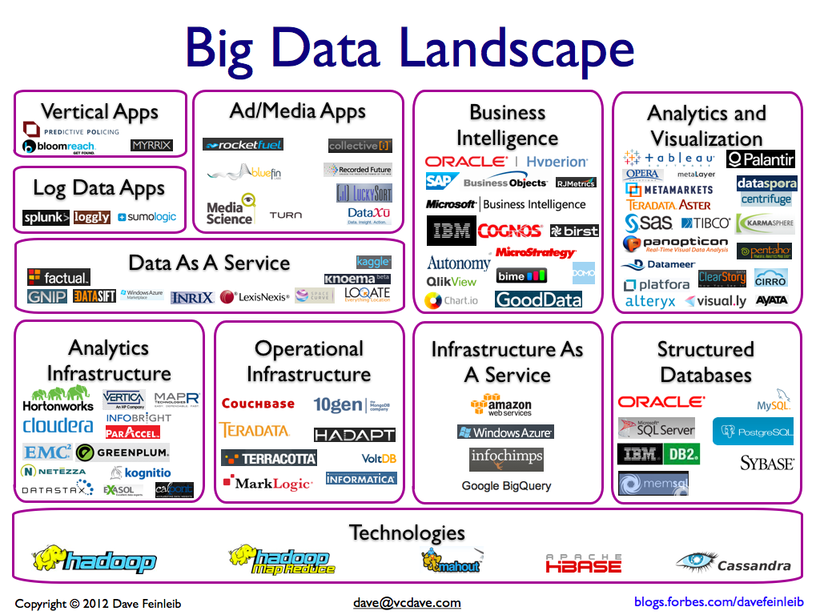
16

Slide 17
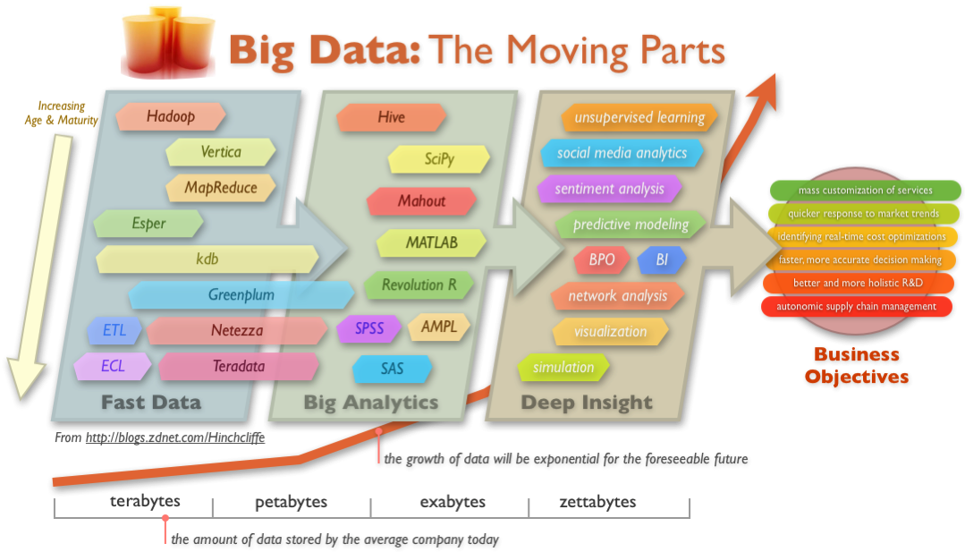
Big Data Technology
17

Slide 18
Google file system
18

Slide 19
File System
File system is a method for storing and organizing computer files.
Most file systems make use of an underlying data storage device such as Hard Disks that offers access to an array of fixed-size blocks which is the smallest logical amount of disk space that can be allocated to hold a file.
File systems typically have directories which associate file names with files, usually by connecting the file name to an index in a file allocation table of some sort, such as the FAT in a DOS file system, or an inode in a Unix-like file system.
File names are simple strings, and per-file Metadata is maintained which is the bookkeeping information, typically associated with each file within a file system.
Metadata could contain file attributes such as file size, data and time of creation or modification of the file, owner of the file, access permissions etc.
19

Slide 20
Types of File System
File system types can be classified into disk file systems, network file systems and flash file systems.
A disk file system is a file system designed for the storage of files on a data storage device, most commonly a disk drive e.g. FAT, NTFS, etx2, ext3 etc.
A network file system is a file system that acts as a client for a remote file access protocol, providing access to files on a server e.g. NFS, SMB etc.
A flash file system is a file system designed for storing files on flash memory devices.
20

Slide 21
File System & OS
Operating systems provide a file system, as a file system is an integral part of any modern operating system.
Windows Operating system supports FAT and NTFS File Systems
Linux popularly supports ext2 and ext3 File Systems
Other flavors of Operating Systems may support other File Systems like UFS in many UNIX Operating Systems and HFS in MAC OS X.
All Operating Systems provide a user interface like Command Line (CLI) or File Browser to access and manage File System information.
21

Slide 22
FAT
The File Allocation Table (FAT) file system was initially developed for DOS Operating System and was later used and supported by all versions of Microsoft Windows.
It was an evolution of Microsoft's earlier operating system MS-DOS and was the predominant File System in Windows versions like 95, 98, ME etc.
All the latest versions of Windows still support FAT file system although it may not be popular.
FAT had various versions like FAT12, FAT16 and FAT32. Successive versions of FAT were named after the number of bits in the table: 12, 16 and 32.
22

Slide 23
NTFS
NTFS or the NT File System was introduced with the Windows NT operating system.
NTFS allows ACL-based permission control which was the most important feature missing in FAT File System.
Later versions of Windows like Windows 2000, Windows XP, Windows Server 2003, Windows Server 2008, and Windows Vista also use NTFS.
NTFS has several improvements over FAT such as security access control lists (ACL) and file system journaling.
23

Slide 24
File System in Linux
Linux supports many different file systems, but common choices for the system disk include the ext family (such as ext2 and ext3), XFS, JFS and ReiserFS.
The ext3 or third extended file system is a journaled file system and is the default file system for many popular Linux distributions .
It is an upgrade of its predecessor ext2 file system and among other things it has added the journouling feature.
A journaling file system is a file system that logs changes to a journal (usually a circular log in a dedicated area) before committing them to the main file system. Such file systems are less likely to become corrupted in the event of power failure or system crash.
24

Slide 25
Google file system
Introduction
GFS is a scalable distributed file system for large data intensive applications
Shares many of the same goals as previous distributed file systems such as performance, scalability, reliability, and availability.
The design of GFS is driven by four key observations
Component failures, huge files, mutation of files, and benefits of co-designing the applications and file system API
25

Slide 26
Google file system
Assumptions
GFS has high component failure rates
System is built from many inexpensive commodity components
Modest number of huge files
A few million files, each typically 100MB or larger (Multi-GB files are common)
No need to optimize for small files
Workloads : two kinds of reads, and writes
Large streaming reads (1MB or more) and small random reads (a few KBs)
Small random reads
Sequential appends to files by hundreds of data producers
High sustained throughput is more important than latency
Response time for individual read and write is not critical
26

Slide 27
Google file system
GFS Design Overview
Single Master
Centralized management
Files stored as chunks
With a fixed size of 64MB each.
Reliability through replication
Each chunk is replicated across 3 or more chunk servers
Data caching
Due to large size of data sets
Interface
Suitable to Google apps
Create, delete, open, close, read, write, snapshot, record append
27

Slide 28
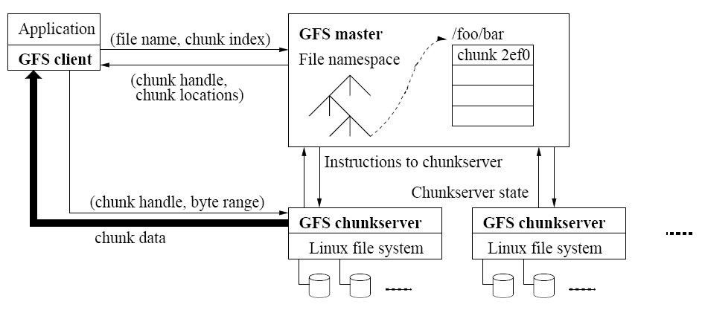
Google file system
GFS Architecture
28

Slide 29
Google file system
Master
Master maintains all system metadata
Name space, access control info, file to chunk mappings, chunk locations, etc.
Periodically communicates with chunk servers
Through HeartBeat messages
Advantages:
Simplifies the design
Disadvantages:
Single point of failure
solution
Replication of Master state on multiple machines
Operational log and check points are replicated on multiple machines
29

Slide 30
Google file system
Chunks
Fixed size of 64MB
Advantages
Size of meta data is reduced
Involvement of Master is reduced
Network overhead is reduced
Lazy space allocation avoids internal fragmentation
Disadvantages
Hot spots
Solutions: increase the replication factor and stagger application start times; allow clients to read data from other clients
30

Slide 31
Google file system
Metadata
Three major types of metadata
The file and chunk namespaces
The mapping from files to chunks
Locations of each chunk’s replicas
All the metadata is kept in the Master’s memory
Master “operation log”
Consists of namespaces and file to chunk mappings
Replicated on remote machines
64MB chunk has 64 bytes of metadata
Chunk locations
Chunk servers keep track of their chunks and relay data to Master through HeartBeat messages
31

Slide 32
Google file system
Operation log
Contains a historical record of critical metadata changes
Replicated to multiple remote machines
Changes are made visible to clients only after flushing the corresponding log record to disk both locally and remotely
Checkpoints
Master creates the checkpoints
Checkpoints are created on separate threads
32

Slide 33
Google file system
Consistency Model
Atomicity and correctness of file namespace are ensured by namespace locking
After successful data mutation(writes or record appends), changes are applied to a chunk in the same order on all replicas.
In case of chunk server failure at the time of mutation (stale replica), it is garbage collected at the soonest opportunity.
Regular handshakes between Master and chunk servers helps in identifying failed chunk servers and detects data corruption by checksumming.
33

Slide 34
Google file system
System Interactions: Leases & Mutation Order
Master grants chunk lease to one of the replicas(primary).
All replicas follow a serial order picked by the primary.
Leases timeout at 60 seconds.(also possible to extend the timeout)
Leases are revocable.
34

Slide 35
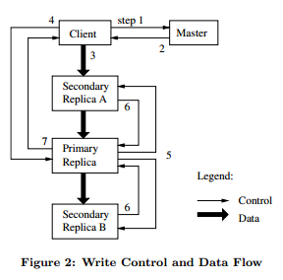
Google file system
System Interactions
1.Client asks master which chunk server holds current lease of chunk and locations of other replicas.
2.Master replies with identity of primary and locations of secondary replicas.
3.Client pushes data to all replicas
4.Once all replicas have acknowledged receiving the data, client sends write request to primary. The primary assigns consecutive serial numbers to all the mutations it receives, providing serialization. It applies mutations in serial number order.
5.Primary forwards write request to all secondary replicas. They apply mutations in the same serial number order.
6.Secondary recplicas reply to primary indicating they have completed operation
7.Primary replies to the client with success or error message
35

Slide 36
Google file system
System Interactions
Data Flow
Data is pipelined over TCP connections
A chain of chunk servers form a pipeline
Each machine forwards data to the closest machine
Atomic Record Append
“record append”
Snapshot
Makes a copy of file or a directory tree almost instantaneously
36

Slide 37
Google file system
Master Operation – Namespace Management & Locking
Locks are used over namespaces to ensure proper serialization
Read/write locks
GFS simply uses directory like file names : /foo/bar
GFS logically represents its namespace as a lookup table mapping full pathnames to metadata
If a Master operation involves /d1/d2/../dn/leaf, read locks are acquired on d1,/d1/d2,..d1/d2/../leaf and either a read or write lock on the full pathname /d1/d2/…..dn/leaf
37

Slide 38
Google file system
Master Operation
Garbage collection
Lazy deletion of files
Master deletes a hidden file during its regular scan if the file have existed for 3 days
HeartBeat messages are used to inform the chunk servers about the deleted files chunks
Stale Replica Detection
The Master maintains a chunk version number
The Master removes stale replicas in its regular garbage collection
38

Slide 39
Google file system
Fault Tolerance
Fast Recovery
Chunk Replication
Master Replication
Data Integrity
39

